Slide 1
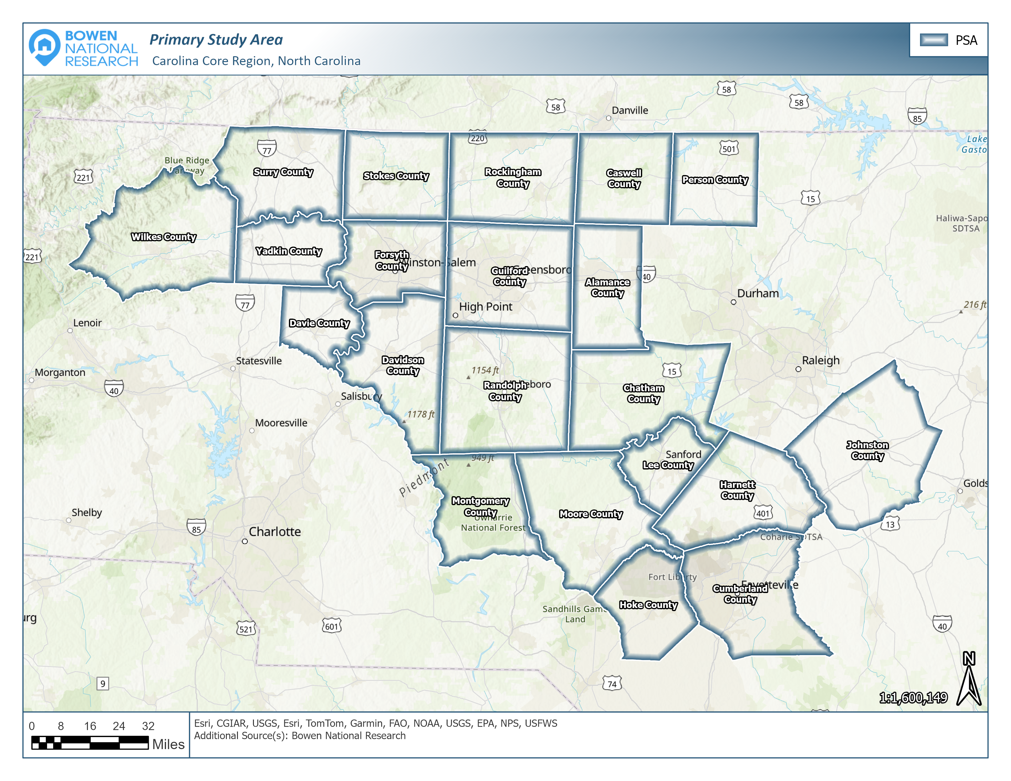
Carolina Core Housing Needs Assessment Guilford, Randolph & rockingham Counties Presentation
February 2025
CONTACT: Patrick Bowen
patrickb@bowennational.com
614-833-9300

Slide 2
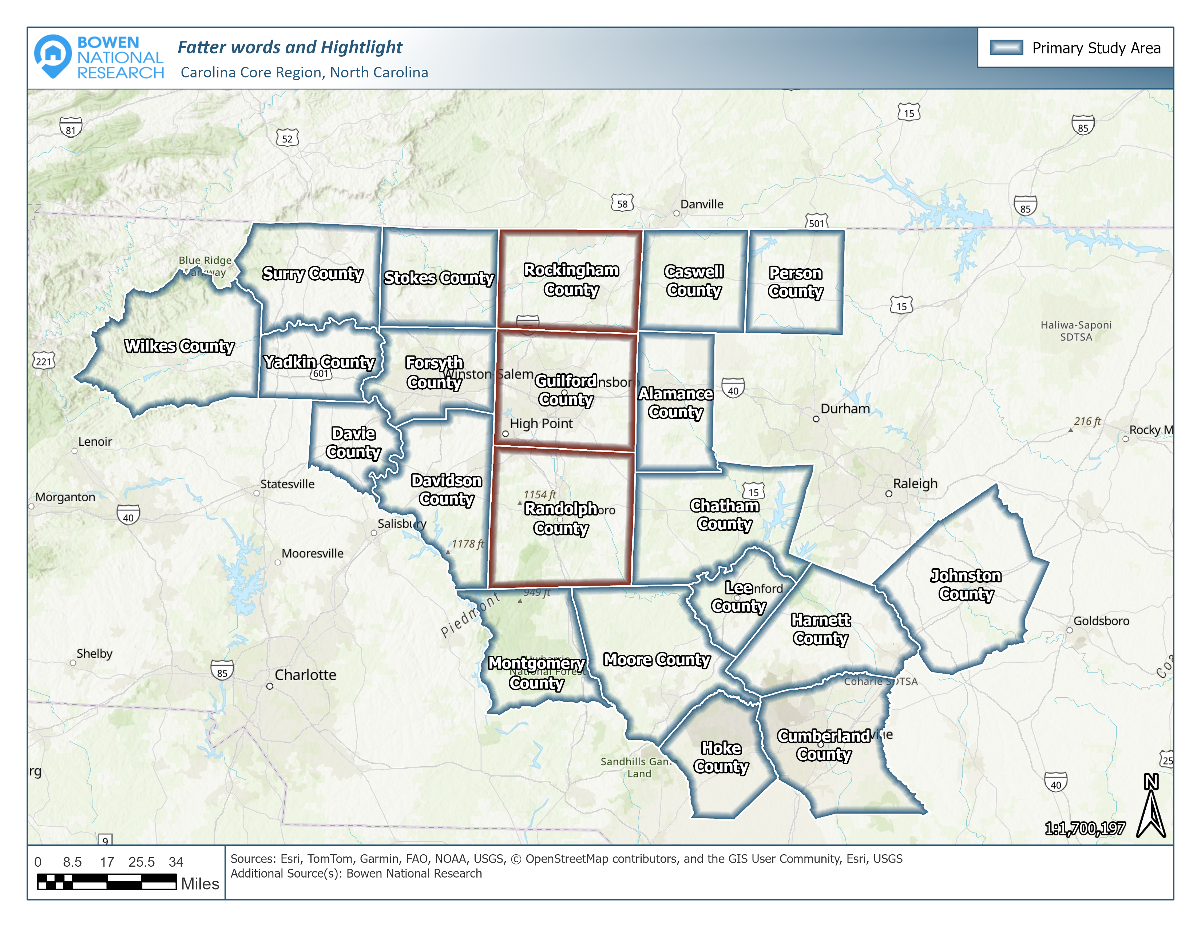
CAROLINA CORE REGIONAL STUDY AREA
The Primary Study Area (PSA) was the Carolina Core Region which encompasses 21 contiguous counties in the northcentral and central portions of North Carolina.

Slide 3
Scope of Work
Demographic Characteristics and Trends
Economic Conditions, Investments and Initiatives
Housing Stock Availability, Costs, Performance, and Conditions
Survey of 761 Multifamily Apartments
Inventory of 1,043 Available Non-Conventional Rentals
Inventory of 164,742 Recently Sold (Since 2020) Housing Units
Inventory of 3,966 Currently Available For-Sale Housing Units
Identification of 18,602 Residential Housing Units in the Development Pipeline
Community Input (Survey of Stakeholders, Employers and Residents/Commuters)
Over 2,300 People Participated
Housing Gap Estimates for Rental and For-Sale Product by Various Levels of Affordability
Well over 3,000 points of contact were made as part of the study!

Slide 4
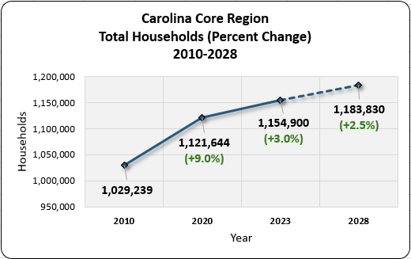
Demographics – Overall Household Growth Trends
The number of households in the region grew significantly since 2010, increasing by 125,661 (12.2%). The region’s growth rates are slightly below the state average. The region is projected to add 28,930 households between 2023 and 2028.

Slide 5
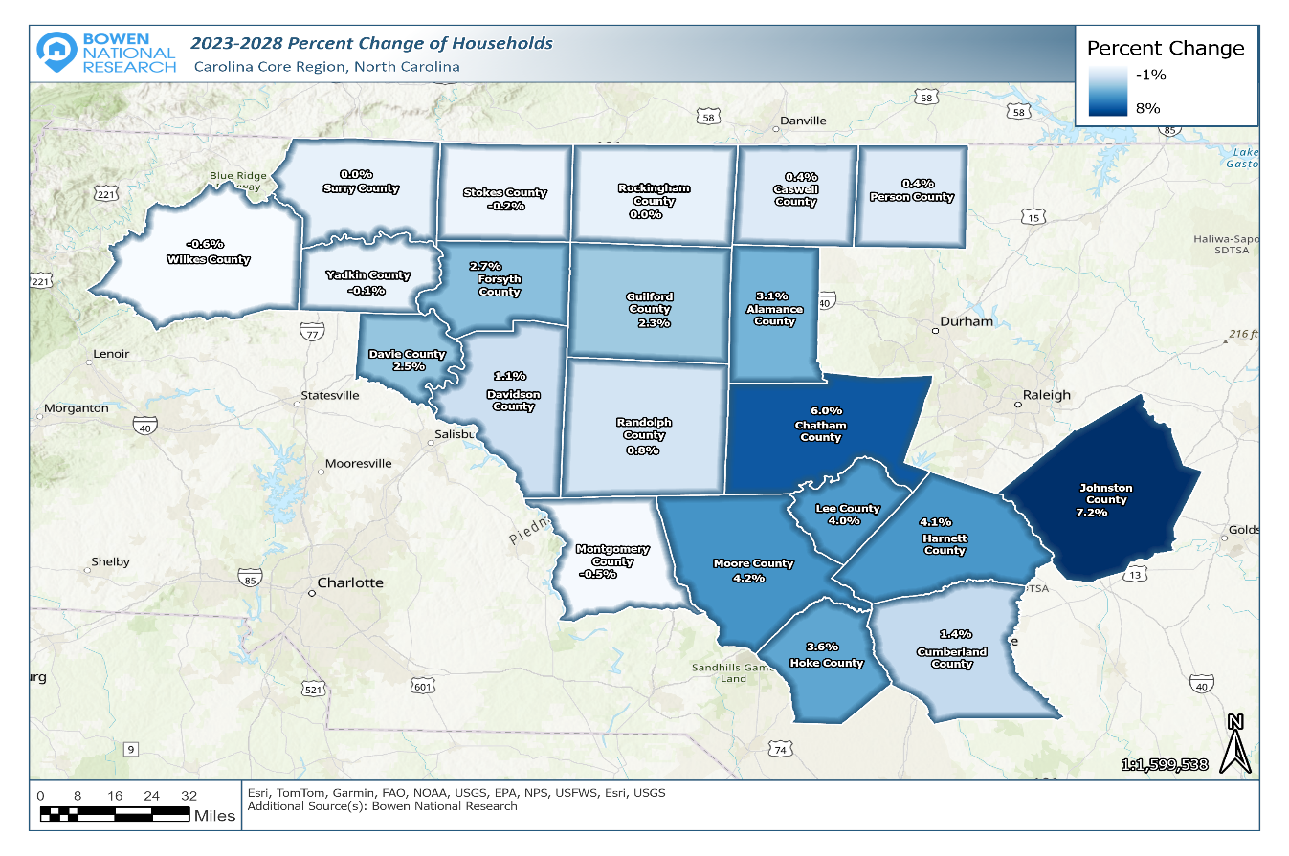
Demographics – Percent Change in Households (2023-2028)
The greatest household growth is projected to occur along the I-40 corridor, generally between Davie and Alamance counties, and extending southeast to Cumberland County. Johnston County has the greatest projected percent increase (7.2%) in new households, as well as the number of new households (6,254). The counties of Forsyth and Guilford will both add over 4,000 new households.
2 of 3 subject counties are projected to grow:
Guilford: 5,157 Households
Randolph: 473 Households
Rockingham: -2 Households

Slide 6
Demographics – Renter Households by Income
Carolina Core Region
Most renter household growth is projected to be among those earning $50k+, while the majority of renter households will continue to earn less than $50k in most counties.

Slide 7
Demographics – Renter Households by Income

Slide 8
Demographics – Owner Households by Income
Carolina Core Region
Most owner household growth is projected to be among those earning $100k+, while roughly two-thirds of owner households will continue to earn less than $100k in most counties.

Slide 9
Demographics – Owner Households by Income

Slide 10
Demographics – Households by Age Cohort
While Guilford County will experience some growth of households ages 35 to 54, the other two subject counties will have minor declines.

Slide 11
Demographics – Households by Age Cohort

Slide 12
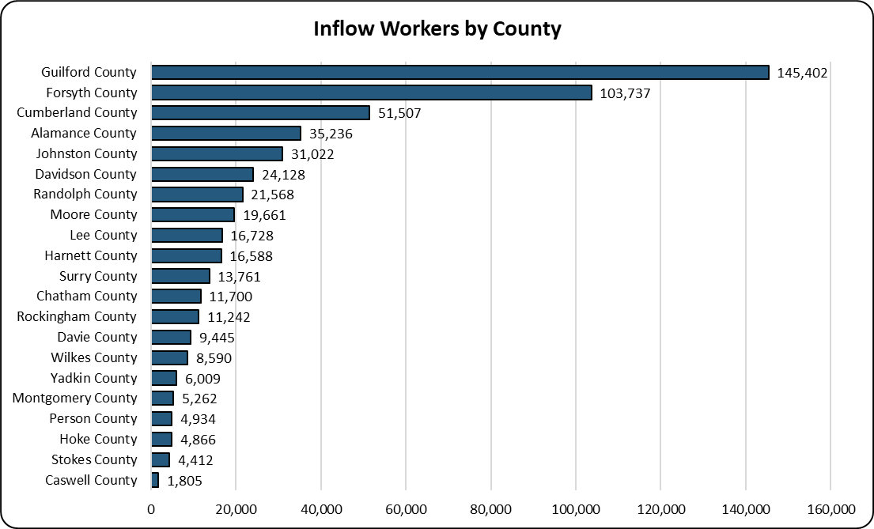
Potential Commuter Impact
Inflow workers originate from a county outside of their county of employment. Guilford County (145,402) has the largest number of inflow workers in the Carolina Core Region, while the counties of Rockingham and Randolph have between 11,242 and 21,568 inflow commuters, respectively. These commuters represent potential residents in their respective work counties.

Slide 13
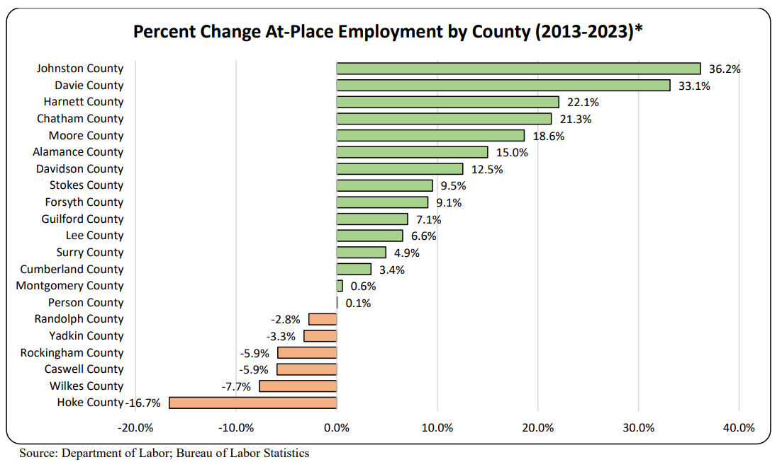
Economics – Job Growth (Historical & Future)
While Guilford County experienced positive job growth between 2013 and 2023, all three subject counties are expected to have significant economic investment and job growth over the next few years.

Slide 14
Housing Supply – Housing Age and Condition
Substandard housing is typically considered older product often having units that are overcrowded and/or lack complete plumbing or kitchen facilities.
 | Housing Age and Conditions (2022)
 | Pre-1970 Product |  |  |  | Overcrowded |  |  |  | Incomplete Plumbing or Kitchen
 | Renter |  | Owner |  | Renter |  | Owner |  | Renter |  | Owner
 | # | % | # | % | # | % | # | % | # | % | # | %
Guilford | 23,975 | 27.8% | 35,166 | 27.8% | 3,527 | 4.1% | 2,206 | 1.7% | 2,040 | 2.4% | 439 | 0.3%
Randolph | 4,523 | 30.9% | 10,412 | 25.2% | 737 | 5.0% | 554 | 1.3% | 894 | 6.1% | 321 | 0.8%
Rockingham | 4,359 | 39.3% | 9,309 | 33.7% | 391 | 3.5% | 226 | 0.8% | 345 | 3.1% | 138 | 0.5%
Region | 99,880 | 27.0% | 178,181 | 24.2% | 13,835 | 3.7% | 11,160 | 1.5% | 6,734 | 1.8% | 3,473 | 0.5%
North Carolina | 324,950 | 23.4% | 581,740 | 21.4% | 55,035 | 4.0% | 36,635 | 1.3% | 22,203 | 1.6% | 14,625 | 0.5%
While Rockingham County has older housing stock, housing quality appears to be a more prevalent challenge for households in Randolph and Guilford counties. Over 8,200 households in Guilford County live in substandard housing.

Slide 15
Housing Affordability – Published Secondary Data
Housing Cost Burdened (Paying Over 30% of Income Toward Housing)
Severe Housing Cost Burdened (Paying over 50% of Income Toward Housing)
 | Household Income, Housing Costs and Affordability
Study Area | Total HH (2023) | Median HH Income (2023) | Median Home Value (2023) | Median Gross Rent (2022) | Share of Cost Burdened HH (2022) |  | Share of Severe Cost Burdened HH (2022)
 |  |  |  |  | Renter | Owner | Renter | Owner
Guilford County | 220,993 | $62,128 | $240,016 | $1,049 | 46.8% | 19.7% | 21.4% | 7.6%
Randolph County | 58,371 | $57,317 | $170,951 | $813 | 40.2% | 16.1% | 18.1% | 7.2%
Rockingham County | 38,861 | $46,862 | $170,233 | $743 | 41.1% | 18.6% | 17.5% | 8.1%
Region | 1,154,900 | $59,604 | $219,542 | $970 | 43.8% | 18.8% | 20.8% | 7.7%
North Carolina | 4,313,434 | $64,316 | $262,945 | $1,093 | 43.6% | 18.9% | 20.8% | 7.7%
Housing affordability among renter households appears to be a more prevalent challenge in Guilford County.

Slide 16
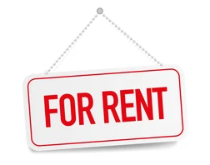
Housing Supply – Multifamily Apartments
A total of 761 multifamily projects were surveyed in the Region with 96,501 total units, of which 5,191 were vacant resulting in an overall 5.4% vacancy rate.
Typically, healthy, well-balanced markets have rental housing vacancy rates generally between 4% and 6%. As such, the 5.4% overall vacancy rate in the Carolina Core Region is generally in line with a balanced or healthy overall multifamily rental housing market.
Surveyed Multifamily Rental Housing Carolina Core Region, North Carolina
Project Type | Projects Surveyed | Total Units | Vacant Units | Occupancy Rate | Vacancy Rate
Market-Rate | 418 | 75,832 | 5,081 | 93.3% | 6.7%
Tax Credit | 136 | 8,253 | 85 | 99.0% | 1.0%
Government-Subsidized | 226 | 12,416 | 25 | 99.8% | 0.2%
Total | 761 | 96,501 | 5,191 | 94.6% | 5.4%
Vacancy rates among the Tax Credit and government-subsidized properties are extremely low, with Tax Credit properties operating at a 1.0% vacancy rate and the government-subsidized supply operating at an overall 0.2% vacancy rate.

Slide 17
Housing Supply – Overall Multifamily Rentals
Three subject counties overall multifamily rental vacancy rates
Rockingham = 1.6%
Randolph = 3.0%
Guilford = 5.3%
Vacancy rates between 4% and 6% are generally considered to be healthy.

Slide 18
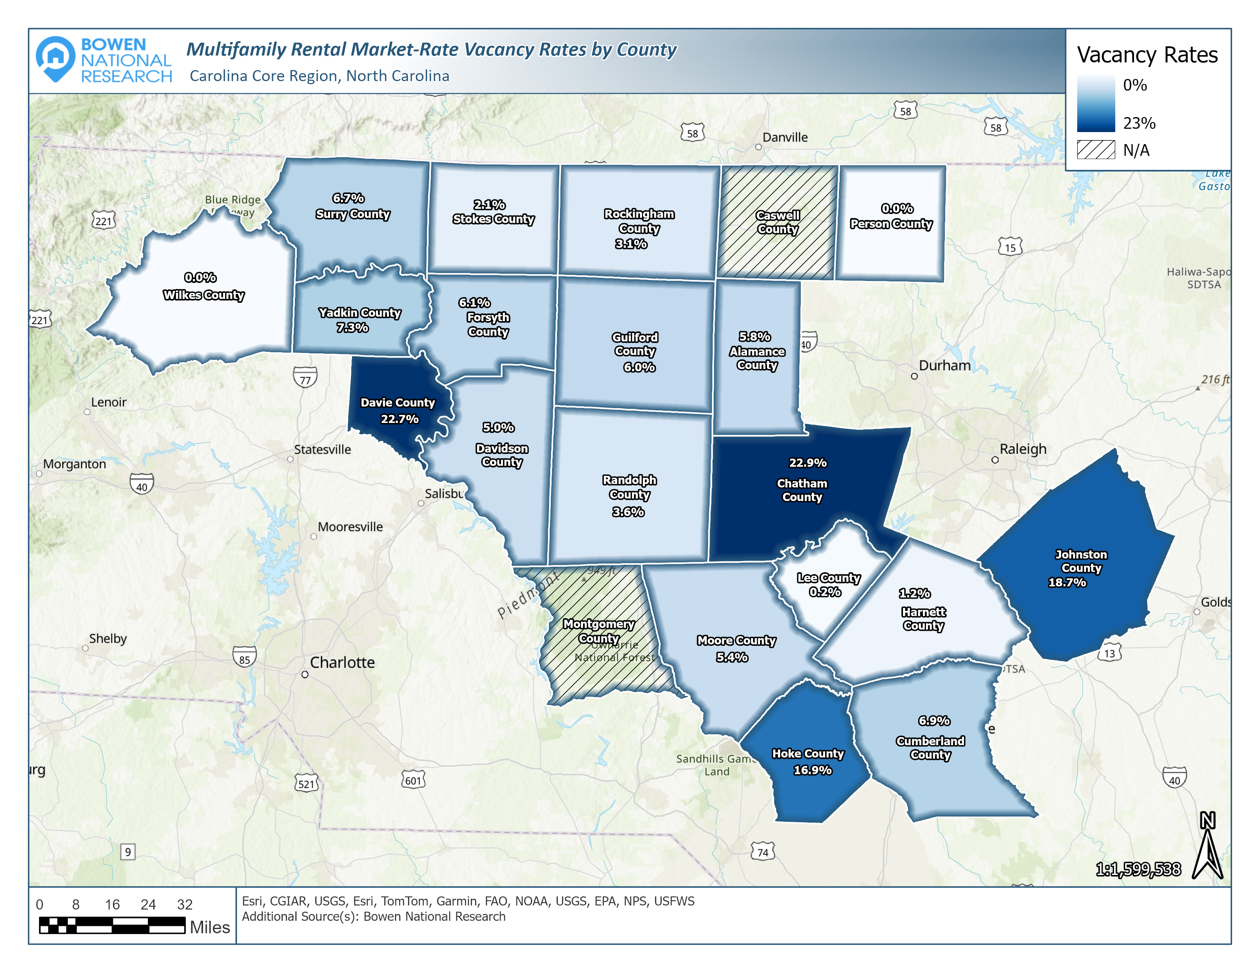
Housing Supply – Market-Rate Multifamily Rentals
Housing Supply – Market-Rate Multifamily Rentals
Three subject counties
market-rate vacancy rates
Rockingham = 3.1%
Randolph = 3.6%
Guilford = 6.0%

Slide 19
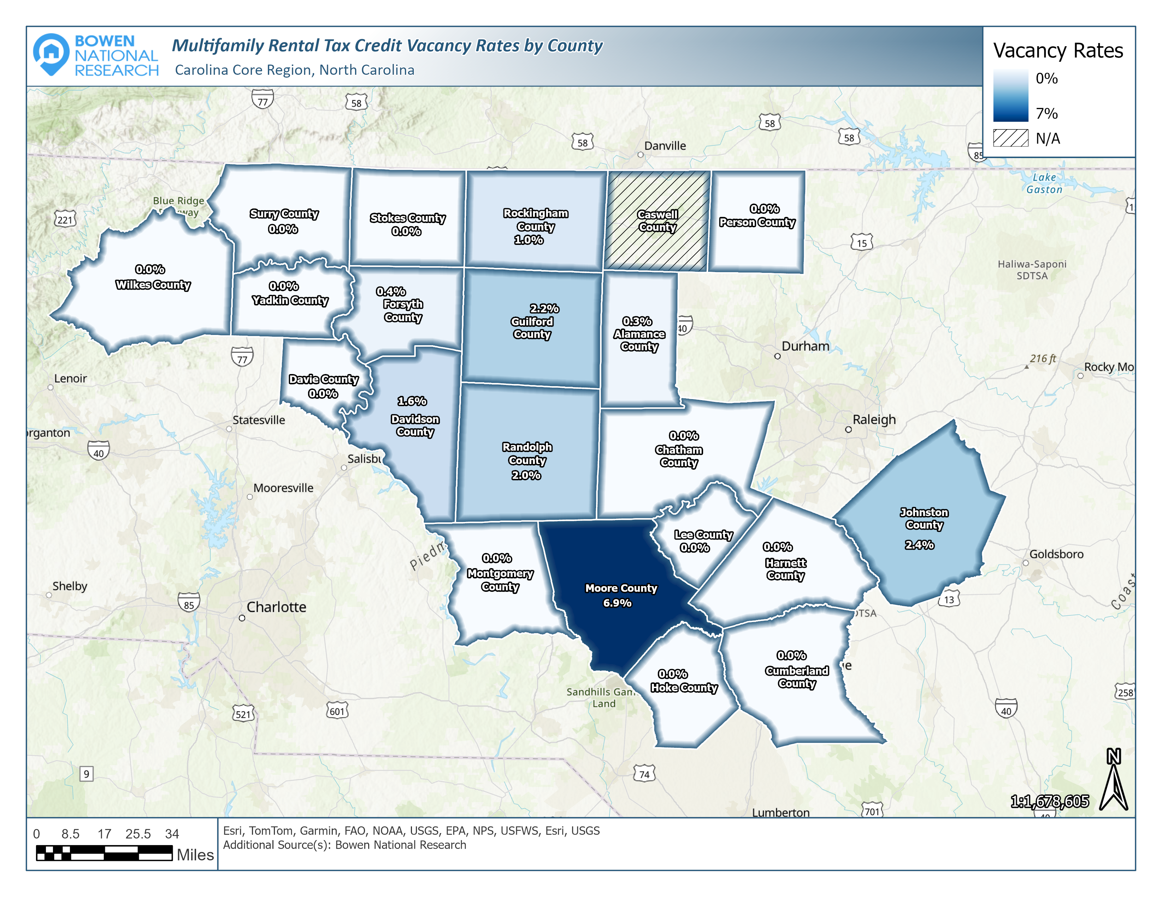
Housing Supply – Tax Credit Multifamily Rentals
Serves households generally earning between $40,000 and $65,000
Three subject counties
Tax Credit vacancy rates
Rockingham = 1.0%
Randolph = 2.0%
Guilford = 2.2%

Slide 20
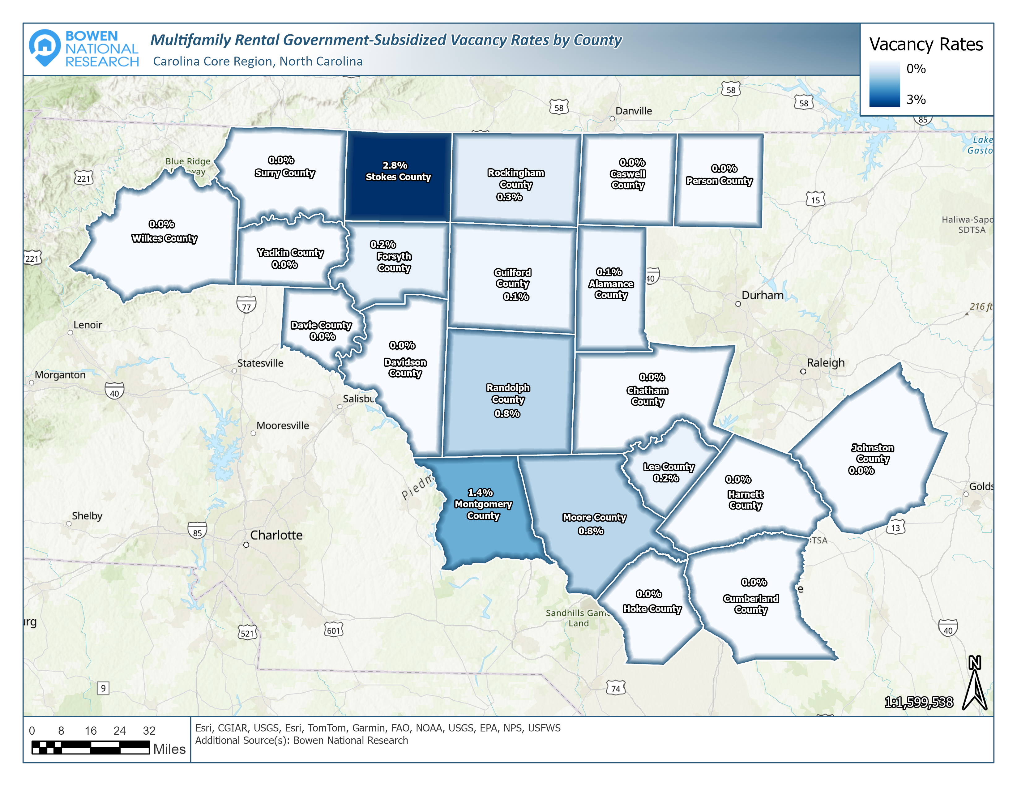
Housing Supply – Government-Subsidized Multifamily Rentals
Serves households generally earning less than $40,000
Three subject counties subsidized vacancy rates
Guilford = 0.1%
Rockingham = 0.3%
Randolph = 0.8%

Slide 21
Surveyed Non-Conventional Rentals Overview
County | Non-Conventional Rentals | Identified Vacant Units | Vacancy Rate
Alamance | 14,550 | 60 | 0.4%
Caswell | 1,937 | 0 | 0.0%
Chatham | 5,270 | 9 | 0.2%
Cumberland | 38,497 | 134 | 0.3%
Davidson | 15,772 | 53 | 0.3%
Davie | 2,368 | 13 | 0.5%
Forsyth | 29,265 | 132 | 0.5%
Guilford | 42,989 | 204 | 0.5%
Harnett | 13,956 | 98 | 0.7%
Hoke | 5,225 | 58 | 1.1%
Johnston | 14,685 | 96 | 0.7%
Lee | 6,380 | 14 | 0.2%
Montgomery | 2,577 | 3 | 0.1%
Moore | 7,569 | 103 | 1.4%
Person | 3,051 | 4 | 0.1%
Randolph | 11,530 | 22 | 0.2%
Rockingham | 8,378 | 15 | 0.2%
Stokes | 3,745 | 8 | 0.2%
Surry | 6,562 | 6 | 0.1%
Wilkes | 6,145 | 10 | 0.2%
Yadkin | 2,935 | 1 | 0.0%
Region | 243,386 | 1,043 | 0.4%
Housing Supply
The lack of available non-conventional rentals is a region-wide challenge. Most have rents ranging from $1,000 to $2,500, which are unaffordable to many of the region’s households.

Slide 22
Housing Supply – Historical Home Sales
While the annual number of homes sold in the Carolina Core Region slowed in 2022 and 2023, the median sales price continued to rise to a high of $315,000 in 2024.
*Projected year-end sales volume (2024)

Slide 23
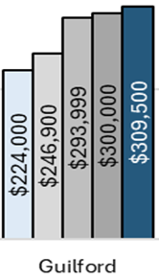
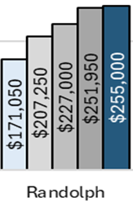
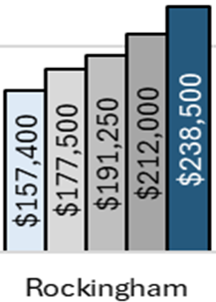
Housing Supply – Historical Home Sales (County-Level)
Annual Median Sales Price by County
2020 to 2024
While the increase in annual median sales prices have slowed in recent years, they remained positive in in all three subject counties in 2024.
Guilford
Randolph
Rockingham
$85,500 (38.2%) increase since 2020
$83,950 (49.1%) increase since 2020
$81,100 (51.5%) increase since 2020

Slide 24
Housing Supply – Available For-Sale Housing
3,966 homes available for purchase in May of 2024
Overall Carolina Core availability rate is just 0.5%, well below the 2%-3% range of healthy markets.
Over one-half (58.1%) of the available supply in the Carolina Core is priced at or above $300,000. Less than 20% of supply priced under $200,000.

Slide 25
Limited availability & short sales periods illustrate a high level of demand of for-sale housing.
 | Available For-Sale Housing by County (As of May 31, 2024)
County | Total Available Units | % Share of Region | Availability Rate | Months Supply of Inventory | Average List Price | Median List Price | Average Days on Market | Average Year Built
Alamance | 173 | 4.4% | 0.4% | 1.0 | $416,576 | $350,000 | 40 | 1980
Caswell | 22 | 0.6% | 0.3% | 2.1 | $265,205 | $234,950 | 30 | 1967
Chatham | 138 | 3.5% | 0.5% | 1.3 | $1,135,990 | $767,500 | 57 | 2001
Cumberland | 495 | 12.5% | 0.7% | 1.2 | $290,528 | $249,900 | 49 | 1983
Davidson | 224 | 5.6% | 0.5% | 1.2 | $450,306 | $346,400 | 58 | 1983
Davie | 63 | 1.6% | 0.5% | 1.4 | $524,169 | $349,900 | 65 | 1981
Forsyth | 455 | 11.5% | 0.5% | 1.0 | $401,521 | $325,000 | 49 | 1981
Guilford | 639 | 16.1% | 0.5% | 1.2 | $402,884 | $330,000 | 55 | 1984
Harnett | 243 | 6.1% | 0.7% | 1.8 | $379,926 | $350,000 | 54 | 1994
Hoke | 63 | 1.6% | 0.5% | 0.8 | $344,252 | $335,000 | 42 | 1997
Johnston | 328 | 8.3% | 0.5% | 0.9 | $416,336 | $377,950 | 42 | 2001
Lee | 98 | 2.5% | 0.6% | 1.8 | $441,339 | $369,950 | 53 | 1984
Montgomery | 143 | 3.6% | 1.8% | 5.2 | $367,839 | $169,000 | 83 | 1994
Moore | 281 | 7.1% | 0.9% | 1.6 | $703,254 | $495,000 | 69 | 1993
Person | 52 | 1.3% | 0.4% | 1.7 | $497,087 | $359,500 | 43 | 1984
Randolph | 113 | 2.8% | 0.3% | 1.2 | $460,124 | $300,000 | 59 | 1978
Rockingham | 161 | 4.1% | 0.6% | 2.2 | $251,821 | $199,900 | 58 | 1955
Stokes | 47 | 1.2% | 0.3% | 1.4 | $321,127 | $289,900 | 60 | 1979
Surry | 108 | 2.7% | 0.5% | 2.3 | $424,403 | $334,450 | 75 | 1966
Wilkes | 92 | 2.3% | 0.5% | 2.6 | $586,327 | $393,500 | 87 | 1979
Yadkin | 28 | 0.7% | 0.2% | 1.5 | $327,957 | $279,900 | 68 | 1966

Slide 26
 | Available For-Sale Housing Units by List Price (As of May 31, 2024)
County | <$100,000 |  | $100,000-$199,999 |  | $200,000-$299,999 |  | $300,000-$399,999 |  | $400,000+
 | Number | Share | Number | Share | Number | Share | Number | Share | Number | Share
Alamance | 0 | 0.0% | 21 | 12.1% | 37 | 21.4% | 48 | 27.7% | 67 | 38.7%
Caswell | 2 | 9.1% | 5 | 22.7% | 8 | 36.4% | 2 | 9.1% | 5 | 22.7%
Chatham | 0 | 0.0% | 0 | 0.0% | 5 | 3.6% | 11 | 8.0% | 122 | 88.4%
Cumberland | 16 | 3.2% | 140 | 28.3% | 158 | 31.9% | 95 | 19.2% | 86 | 17.4%
Davidson | 4 | 1.8% | 29 | 12.9% | 56 | 25.0% | 61 | 27.2% | 74 | 33.0%
Davie | 4 | 6.3% | 11 | 17.5% | 13 | 20.6% | 10 | 15.9% | 25 | 39.7%
Forsyth | 5 | 1.1% | 66 | 14.5% | 126 | 27.7% | 113 | 24.8% | 145 | 31.9%
Guilford | 19 | 3.0% | 96 | 15.0% | 144 | 22.5% | 154 | 24.1% | 226 | 35.4%
Harnett | 3 | 1.2% | 27 | 11.1% | 56 | 23.0% | 85 | 35.0% | 72 | 29.6%
Hoke | 1 | 1.6% | 8 | 12.7% | 15 | 23.8% | 24 | 38.1% | 15 | 23.8%
Johnston | 0 | 0.0% | 16 | 4.9% | 65 | 19.8% | 116 | 35.4% | 131 | 39.9%
Lee | 0 | 0.0% | 2 | 2.0% | 25 | 25.5% | 34 | 34.7% | 37 | 37.8%
Montgomery | 24 | 16.8% | 59 | 41.3% | 14 | 9.8% | 11 | 7.7% | 35 | 24.5%
Moore | 1 | 0.4% | 25 | 8.9% | 23 | 8.2% | 43 | 15.3% | 189 | 67.3%
Person | 0 | 0.0% | 5 | 9.6% | 16 | 30.8% | 10 | 19.2% | 21 | 40.4%
Randolph | 4 | 3.5% | 13 | 11.5% | 39 | 34.5% | 27 | 23.9% | 30 | 26.5%
Rockingham | 23 | 14.3% | 58 | 36.0% | 48 | 29.8% | 14 | 8.7% | 18 | 11.2%
Stokes | 5 | 10.6% | 8 | 17.0% | 13 | 27.7% | 12 | 25.5% | 9 | 19.1%
Surry | 1 | 0.9% | 16 | 14.8% | 33 | 30.6% | 24 | 22.2% | 34 | 31.5%
Wilkes | 3 | 3.3% | 14 | 15.2% | 17 | 18.5% | 14 | 15.2% | 44 | 47.8%
Yadkin | 1 | 3.6% | 5 | 17.9% | 10 | 35.7% | 7 | 25.0% | 5 | 17.9%
Region Total | 116 | 2.9% | 624 | 15.7% | 921 | 23.2% | 915 | 23.1% | 1,390 | 35.0%

Slide 27
Greensboro-High Point MSA
Maximum Affordable Rent by Occupation at Median Wage by Occupation
Carolina Core Region Statistical Areas (May 2023)
Occupation Title | Statistical Area (See Map on Page V-8 for Area Designations)
 | A | B | C | D | E | F | G | H | Average
Cashiers | $663 | $703 | $612 | $674 | $690 | $664 | $594 | $579 | $647
Retail Salespersons | $711 | $787 | $704 | $728 | $786 | $737 | $726 | $731 | $739
Cooks, Fast Food | $583 | $705 | $556 | $579 | $594 | $592 | $575 | $559 | $593
Cooks, Restaurant | $766 | $902 | $743 | $765 | $877 | $768 | $752 | $745 | $790
Fast Food/Counter Workers | $684 | $732 | $682 | $687 | $705 | $718 | $653 | $677 | $692
Waiters and Waitresses | $478 | $649 | $496 | $529 | $681 | $461 | $501 | $456 | $531
Office Clerks, General | $891 | $985 | $970 | $903 | $934 | $910 | $854 | $840 | $911
Customer Service Reps | $944 | $1,119 | $843 | $956 | $995 | $927 | $849 | $884 | $939
Bookkeeping/Auditing Clerks | $1,076 | $1,268 | $998 | $1,122 | $1,201 | $1,127 | $1,040 | $980 | $1,101
Laborers and Material Movers | $806 | $876 | $847 | $887 | $868 | $915 | $880 | $833 | $864
Heavy/Tractor-Trailer Drivers | $1,189 | $1,281 | $1,158 | $1,243 | $1,238 | $1,240 | $1,196 | $1,192 | $1,217
Stockers/Order Fillers | $840 | $859 | $797 | $798 | $841 | $802 | $825 | $751 | $814
Misc. Assemblers/Fabricators | $896 | $996 | $880 | $940 | $913 | $956 | $896 | $886 | $920
Elementary School Teachers | $1,206 | $1,294 | $1,169 | $1,263 | $1,423 | $1,278 | $1,207 | $1,274 | $1,264
Registered Nurses | $2,095 | $1,975 | $2,180 | $2,024 | $2,048 | $2,076 | $1,941 | $1,893 | $2,029
Home/Personal Care Aides | $687 | $755 | $662 | $697 | $742 | $711 | $688 | $696 | $705
Nursing Assistants | $918 | $955 | $835 | $900 | $935 | $906 | $869 | $817 | $892
General/Operations Managers | $2,390 | $3,258 | $2,360 | $2,510 | $2,763 | $2,588 | $2,411 | $2,218 | $2,562
Maintenance/Repair Workers | $990 | $1,250 | $985 | $1,113 | $1,155 | $1,103 | $1,112 | $985 | $1,086
Janitors/Cleaners | $739 | $872 | $730 | $716 | $743 | $709 | $723 | $694 | $741
Fair Market Rent (FMR) | $1,215 | $1,290 | $1,171 | $1,091 | $1,646 | $1,079 | $905 | $1,126 | $1,096
Wages and Housing Affordability

Slide 28
Maximum Affordable Purchase Price at Median Wage by Occupation
Carolina Core Region Statistical Areas (May 2023)
Occupation Title | Statistical Area (See Map on Page V-8 for Area Designations)
 | A | B | C | D | E | F | G | H | Average
Cashiers | $88,367 | $93,733 | $81,633 | $89,800 | $91,933 | $88,500 | $79,233 | $77,133 | $86,292
Retail Salespersons | $94,800 | $104,967 | $93,833 | $97,033 | $104,833 | $98,300 | $96,733 | $97,400 | $98,488
Cooks, Fast Food | $77,667 | $94,033 | $74,067 | $77,133 | $79,200 | $78,900 | $76,667 | $74,467 | $79,017
Cooks, Restaurant | $102,067 | $120,300 | $99,100 | $102,000 | $116,933 | $102,367 | $100,300 | $99,367 | $105,304
Fast Food/Counter Workers | $91,233 | $97,600 | $90,900 | $91,633 | $93,933 | $95,700 | $87,100 | $90,200 | $92,288
Waiters and Waitresses | $63,733 | $86,567 | $66,067 | $70,533 | $90,767 | $61,467 | $66,800 | $60,767 | $70,838
Office Clerks, General | $118,733 | $131,333 | $129,367 | $120,400 | $124,500 | $121,267 | $113,867 | $112,033 | $121,438
Customer Service Reps | $125,800 | $149,200 | $112,333 | $127,467 | $132,600 | $123,567 | $113,167 | $117,900 | $125,254
Bookkeeping/Auditing Clerks | $143,500 | $169,067 | $133,000 | $149,533 | $160,067 | $150,300 | $138,600 | $130,667 | $146,842
Laborers and Material Movers | $107,400 | $116,833 | $112,933 | $118,300 | $115,733 | $122,033 | $117,300 | $111,067 | $115,200
Heavy/Tractor-Trailer Drivers | $158,533 | $170,733 | $154,400 | $165,733 | $165,033 | $165,367 | $159,467 | $158,933 | $162,275
Stockers/Order Fillers | $111,933 | $114,567 | $106,233 | $106,433 | $112,167 | $106,900 | $109,967 | $100,133 | $108,542
Misc. Assemblers/Fabricators | $119,467 | $132,833 | $117,267 | $125,300 | $121,767 | $127,467 | $119,433 | $118,167 | $122,713
Elementary School Teachers | $160,733 | $172,467 | $155,833 | $168,333 | $189,767 | $170,333 | $160,967 | $169,800 | $168,529
Registered Nurses | $279,300 | $263,300 | $290,633 | $269,833 | $273,033 | $276,733 | $258,767 | $252,367 | $270,496
Home/Personal Care Aides | $91,600 | $100,700 | $88,200 | $92,900 | $98,933 | $94,733 | $91,667 | $92,800 | $93,942
Nursing Assistants | $122,433 | $127,333 | $111,333 | $119,933 | $124,600 | $120,833 | $115,867 | $108,967 | $118,913
General/Operations Managers | $318,700 | $434,367 | $314,667 | $334,700 | $368,433 | $345,000 | $321,500 | $295,767 | $341,642
Maintenance/Repair Workers | $132,033 | $166,600 | $131,300 | $148,333 | $154,000 | $147,000 | $148,233 | $131,333 | $144,854
Janitors/Cleaners | $98,500 | $116,233 | $97,267 | $95,500 | $99,033 | $94,567 | $96,333 | $92,500 | $98,742
Median Available List Price | $350,000 | $563,500 | $292,450 | $276,633 | $377,950 | $318,220 | $332,808 | $350,000 | $343,224
Greensboro-High Point MSA
Wages and Housing Affordability

Slide 29
Housing Gap Estimates – Rental Units
Rental housing gap among three subject counties totals 19,526 units
Guilford: 14,715 Units
Randolph: 3,037 Units
Rockingham: 1,774 Units

Slide 30
Housing Gap Estimates – For-Sale Units
For-sale housing gap among three subject counties totals 29,369 units
Guilford: 18,495 Units
Randolph: 7,603 Units
Rockingham: 3,271 Units

Slide 31
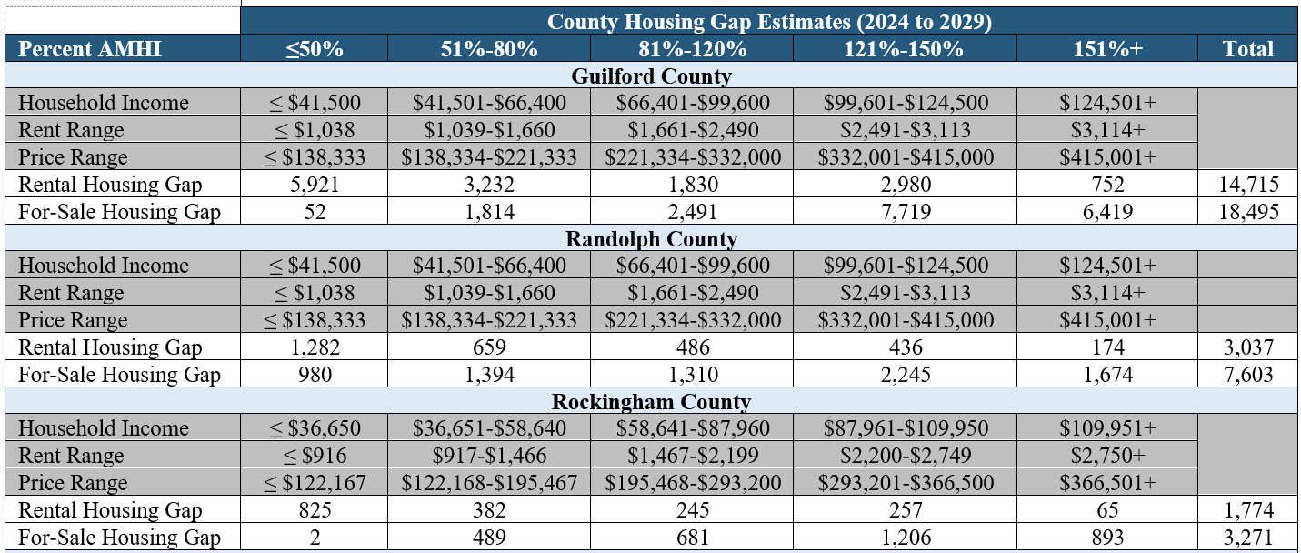
County Rental and For-Sale Housing Gap Estimates by Affordability Level
The greatest rental housing gaps in each county are for product affordable to households at or below 80% of AMHI, while larger for-sale gaps are for product affordable to households at 121% or more of AMHI

Slide 32
Community Input (Resident/Commuter Survey)
Resident Housing Issues:
Cost Burdened (Paying more than 30% of income toward housing costs)
Outdated housing
Lack of sufficient rental deposit or down payment
Housing Most needed:
Rental Housing (Less than $1,250/Month)
For-Sale Housing (Less than $250,000)
Modern Move-In Ready Single-Family Homes
Ranch Homes/Single-Story Floor Plans
Non-Resident Commuters:
72% of non-regional residents would move to region if housing was available and affordable
2,009 People Responded to Survey
Carolina Core Region, North Carolina Summary of Resident/Commuter Survey Results
Category | Top Needs / Issues | Consensus
Housing Issues Experienced within Region | None Cost Burdened (Paying more than 30% of income toward housing costs) Outdated housing | 60.8% 21.3% 10.8%
Issues Negatively Impacting Housing Market | High prices or rents Not Enough Housing/Rental Options (Few Vacancies) Mismatch Between Local Jobs/Wages and Housing Costs | 63.8% 40.0% 27.1%
Degree of Need for Future Housing Product | Rental Housing (Less than $1,250/Month) For-Sale Housing (Less than $150,000) For-Sale Housing ($150,000 - $250,000) | 85.8* 83.1* 75.5*
Degree of Need for Housing Styles | Ranch Homes/Single Floor Plan Units Modern Move-In Ready Single-Family Homes Low-Cost Fixer-Uppers (Single-Family Homes) | 80.6* 78.1* 65.5*
Greatest Need for Housing by Household Group | Millennials (Ages 25 to 44) Middle Age (Ages 45 to 54) Young Persons (Under Age 25) | 61.5% 11.3% 10.5%
Reasons for Not Relocating to County of Choice | High Prices or Rents Lack of Sufficient Deposit or Down Payment Not Enough Housing/Rental Options to Choose From (Few Vacancies) | 57.4% 17.5% 17.1%
Main Reason for Not Relocating to County of Choice:
High Housing Prices or Rents

Slide 33
Community Input (Employer Survey)
214 Employers Responded to Survey
Noteworthy Responses:
Over three-quarters (78.8%) of employers indicated that the lack of affordable housing adversely impacts employees.
The majority of employers indicated that they have had difficulty attracting employees due to the area’s housing issues, while a notable share of respondents indicated that these issues have also presented barriers in employee retention.
Over 30% of employers indicated they would consider expanding/hiring additional staff if additional housing was provided in the region.
Carolina Core Region Summary of Employer Survey Results
Category | Findings / Needs / Issues | Consensus/ Share
Housing Aspects Adversely Impacting Employees | Affordability of Housing Availability of Housing | 78.8% 56.4%
Impacts for Employers from Housing Issues | Difficulty Attracting Employees Difficulty Retaining Employees Adds to Company Costs/Expenses | 52.8% 31.8% 28.4%
Current Housing Assistance Provided by Employer | Do Not Currently Provide Housing Assistance to Employees Provides Some Type of Housing Assistance to Employees Not Directly Involved with Housing | 56.2% 24.7% 19.1%
Potential Housing Assistance Provided by Employer | Would Not Consider Maybe Would Consider | 47.7% 40.0% 12.3%
Housing Assistance Program Consideration | Participating in a Housing Resource Center/Website Partnering with Others to Develop Employee Housing No Interest | 26.5% 24.5% 23.5%
Type of Housing Assistance Provided by Employer | None Employee Relocation Services/Reimbursements | 67.0% 19.0%
Impact of Employer Housing Tax Credit on Involvement in Employee Housing | Unknown More Likely to Offer Housing Assistance to Employees More Likely to be Involved in Developing Employee Housing | 63.1% 22.3% 15.5%
Consider Increasing Number of Employees if Adequate Housing Available | Unknown Would Consider Expanding/Hiring Additional Staff Would Not Consider Expanding/Hiring Additional Staff | 40.4% 34.8% 24.8%

Slide 34
Community Input (Stakeholder Survey)
143 Stakeholders Responded to Survey
Noteworthy Responses:
Most common housing issues include availability and affordability for lower-income residents
Homeowners could benefit from: down payment assistance, home repair loans/grants, homebuyer education program, credit repair, and access to credit/home mortgages
Renters could benefit from: renter education program, rent guarantees for landlords, credit repair, and security deposit assistance
Carolina Core Region, North Carolina Summary of Stakeholder Survey Results
Category | Top Needs / Issues | Consensus
Housing Issues Prevalent in Area/Region | Affordability of Housing Availability of Housing | 95.1% 93.5%
Options to Reduce Housing Issues among Homeowners | Down Payment Assistance Home Repair Loans/Grants Homebuyer Education Program Credit Repair Access to Credit/Home Mortgages | 56.2% 53.7% 48.8% 47.1% 46.3%
Options to Reduce Housing Issues among Renters | Renter Education Program Rent Guarantees for Landlords Credit Repair Security Deposit Assistance | 50.4% 48.8% 47.1% 46.3%
Common Barriers/Obstacles to Affordable Residential Development | Cost of Labor/Materials Cost of Land Cost of Infrastructure | 64.5% 62.9% 55.7%
Options to Reduce/Eliminate Barriers to Residential Development | Collaboration between Public and Private Sectors Government Assistance with Infrastructure Revisit/Modify Zoning (e.g., Density, Setbacks, etc.) | 60.3% 48.8% 43.8%
Priority of Income Levels for Homeowners/Homebuyers | $40,001 to $60,000 $40,000 or less $60,001 to $80,000 | 1.8* 2.3* 2.3*
Priority of Income Levels for Homeowners/Homebuyers | $40,000 or less $40,001 to $60,000 | 1.4* 1.9*
Housing Needs by Bedroom Type | Two-Bedroom Three-Bedroom or Larger | 1.8* 1.9*
Housing Needs by Market Segment | Young Families (Parents Under Age 30) Single-Parent Households Established Families (Parents Ages 30+) Frail Elderly (Ages 65+ with Physical Issues) Seniors (Ages 62+) | 3.4* 3.7* 4.9* 5.8* 6.1*

Slide 35
Community Input (Stakeholder Survey)
Development Costs, Availability of Land, and Land/Zoning Regulations cited as most common barriers to development.
Common Barriers/Obstacles to Affordable Residential Development
Barrier/Obstacle | Share | Barrier/Obstacle | Share
Cost of Labor/Materials | 64.5% | Financing | 27.4%
Cost of Land | 62.9% | Lack of Public Transportation | 19.4%
Cost of Infrastructure | 55.7% | Uncertainty of Community Housing Needs | 14.5%
Availability of Land | 42.7% | Government Fees | 12.1%
Land/Zoning Regulations | 39.5% | Lack of Community Services | 8.1%
Community Support | 34.7% | Deed/Title Complexity/Heirs Issues | 4.0%
Local Government Regulations ("Red Tape") | 34.7% | Lack of Parking | 1.6%
Lack of Infrastructure | 33.1%

Slide 36
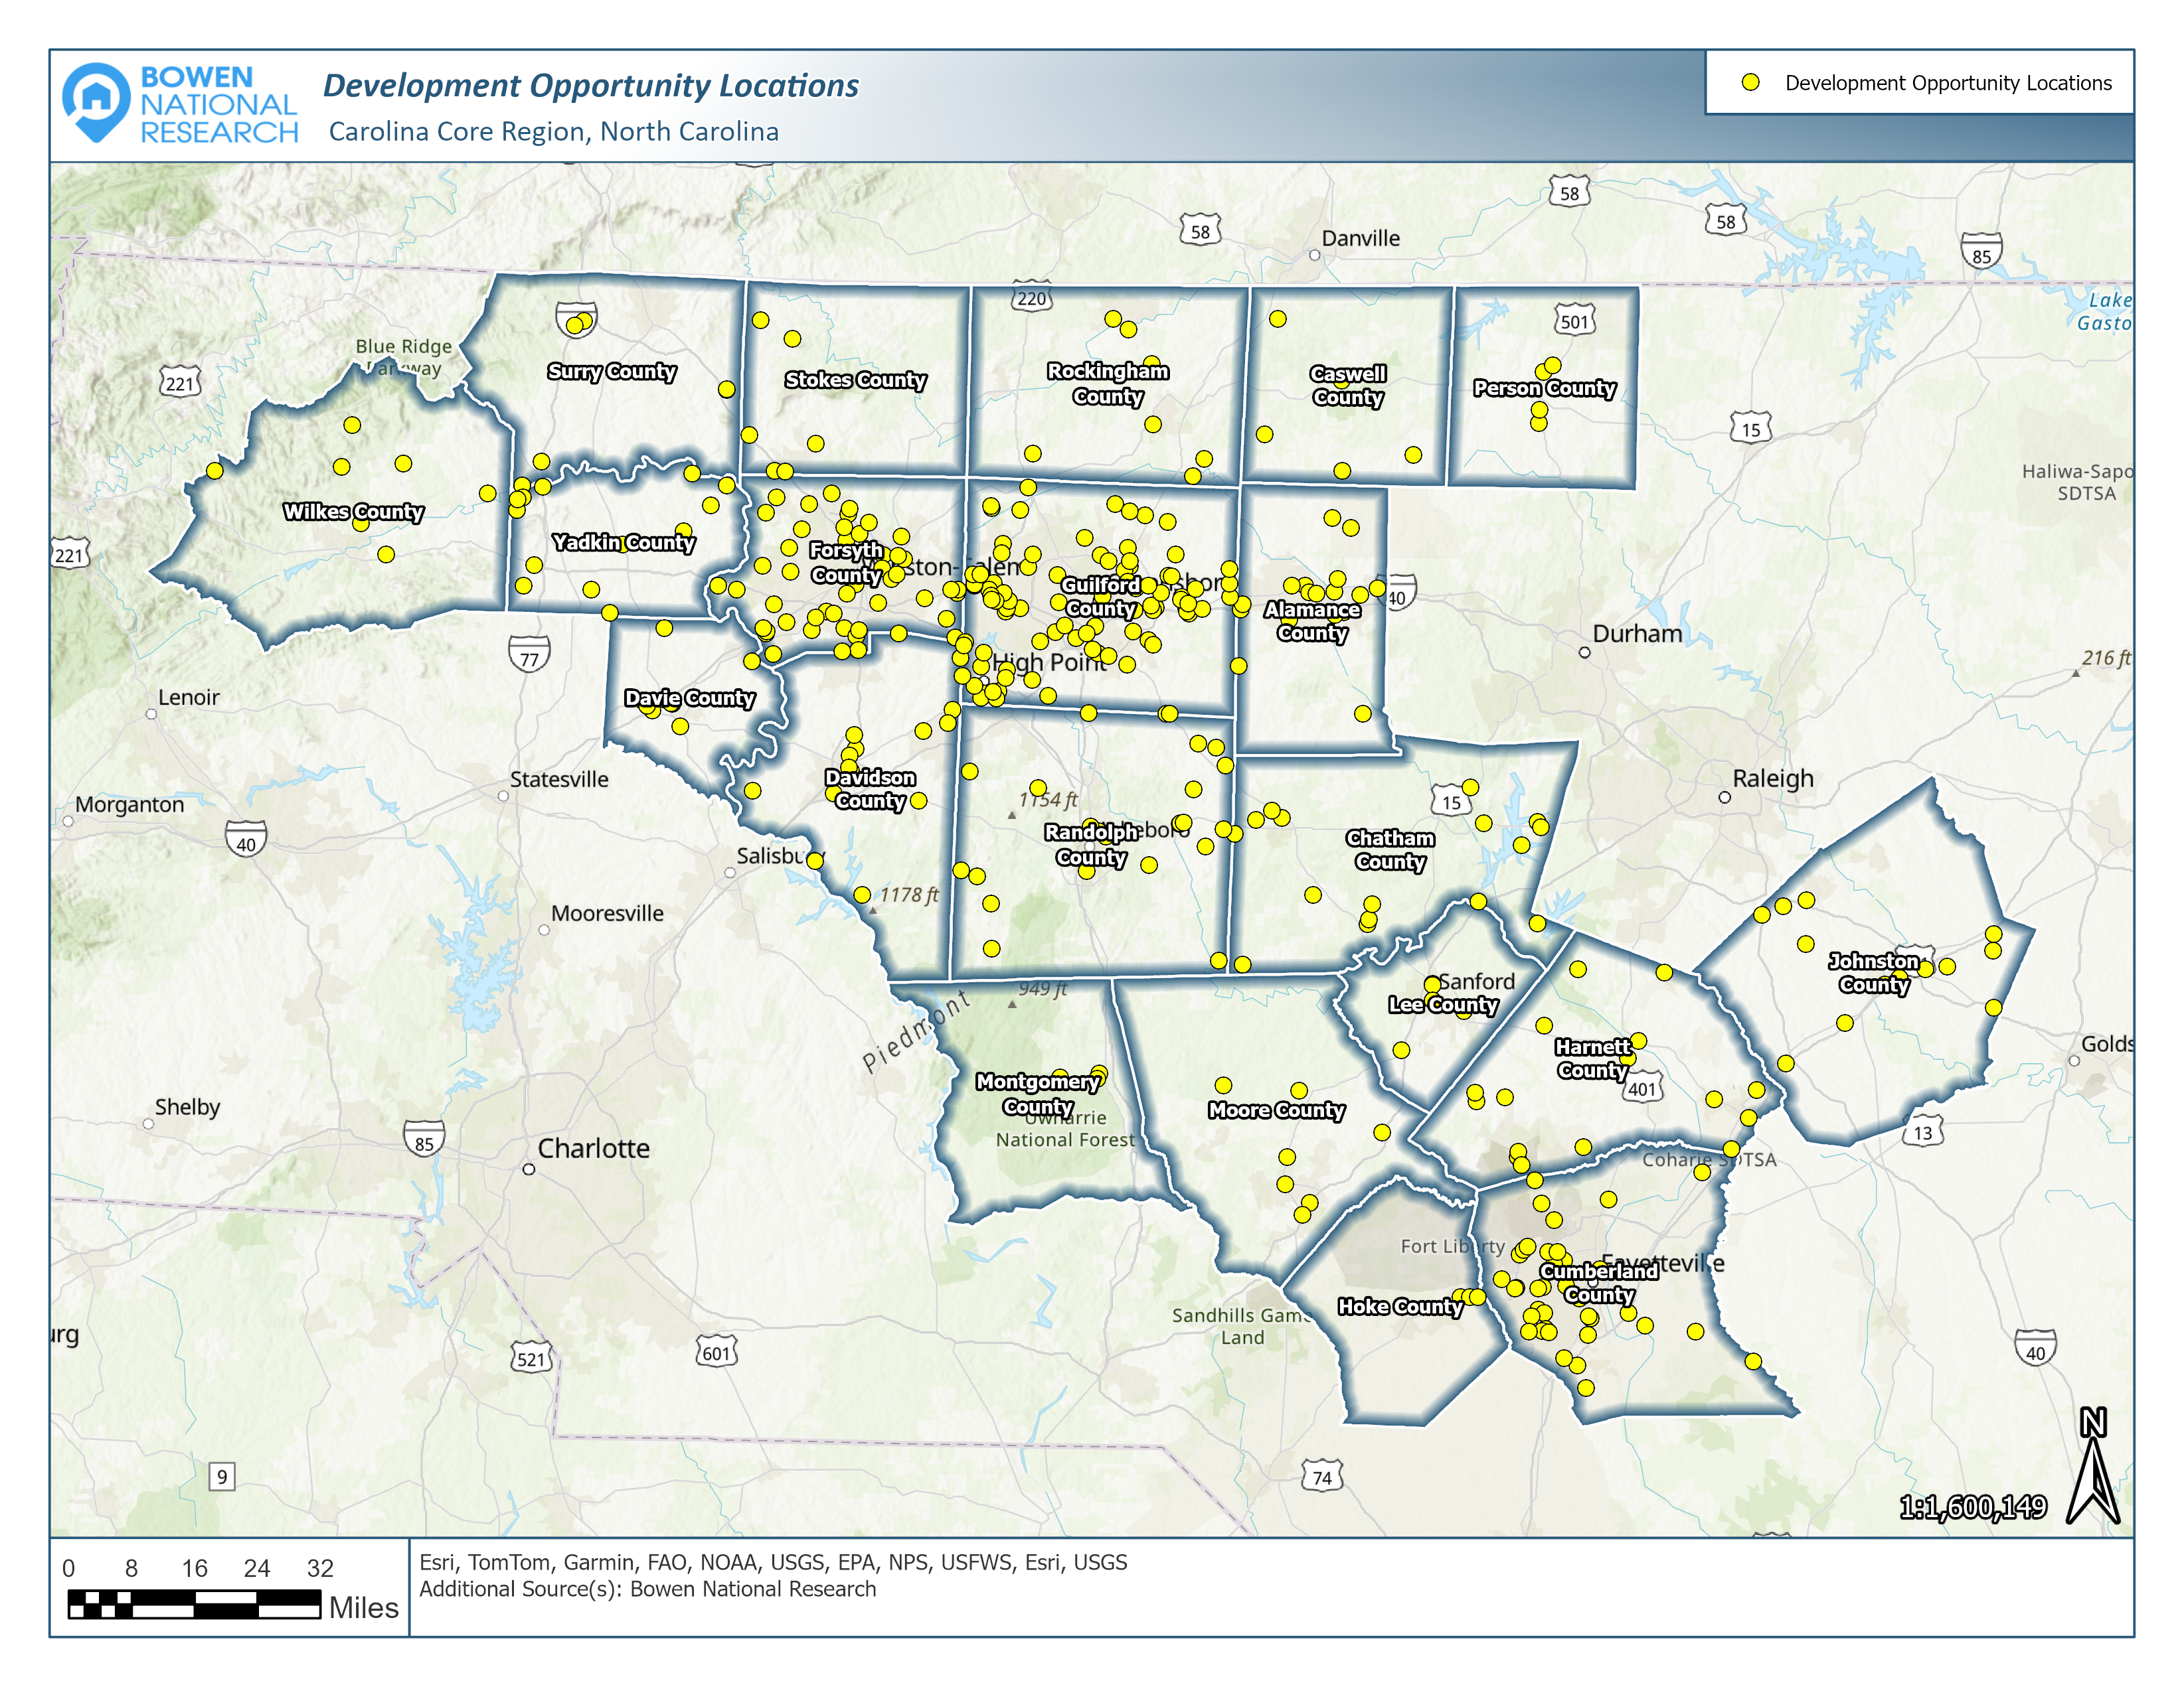
Other Data Sets & Information Provided
Potential Sites (Over 300 Identified)
Possible Development Partners (Over 100 Identified)
Housing Investor/Lender
Atlantic Bay Mortgage Group | www.atlanticbay.com
Bridgewell Capital | https://www.bridgewellcapital.com/
Churchill Stateside Group | https://csgfirst.com
Community Affordable Housing Equity Corporation (CAHEC) | www.cahec.com
Crosland | https://www.crosland.com/
Drucker and Falk | https://www.druckerandfalk.com/
Greenhawk Corp. | https://www.greenhawkcorp.com/
Greystone Affordable Housing Initiatives | www.greystone.com
Hawthorne Residential Partners | https://www.hrpliving.com/
Homestar Financial Corporation | www.homestarfc.com
HomeTrust Bank | https://htb.com
KRP Investments, Inc. | None Found; Phone: 336-817-9400
Movement Mortgage | https://movement.com
North Carolina Housing Finance Agency | www.nchfa.com
PNC Bank | www.pnc.com
RedStone Equity Partners | https://rsequity.com
Redwood Housing Partners, LLC | https://redwoodhousing.com/
Rural Partners Network | https://www.rural.gov/community-networks/nc
State Employees Credit Union | https://www.ncsecu.org
Steele Properties, LLC | https://www.steelellc.com/
Sweetwater Capital | https://www.sweetwatercap.us/about-us/
United States Department of Agriculture (USDA) | www.rd.usda.gov/nc
Wells Fargo | www.wellsfargo.com
Foundations/Nonprofits
DHIC, Inc. | https://dhic.org/
Dogwood Health Trust | https://dogwoodhealthtrust.org

Slide 37
Action Plan Recommendations
Develop Housing Plans
Goal Setting
Capacity Building
Marketing and Outreach
Development of Housing Resource Center
Implement/Modify Policies
Support Residential Development Near Community Services

Slide 38
Contact:
Patrick Bowen
Bowen National Research
Patrickb@bowennational.com
614-833-9300
www.bowennational.com
Questions?
Study Available at:
https://www.ncrealtors.org/carolina-core-housing-study-reports/
Note: Individual County Chapters Also Available

